Slide 1
Exploring Computer Prices
Presented by Hung Nguyen | Cohort 13

Slide 2
"Has the price for a computer significantly increase overtime? What is your recommendation on what laptop/desktop to buy?"
Research Question/Direction

Slide 3
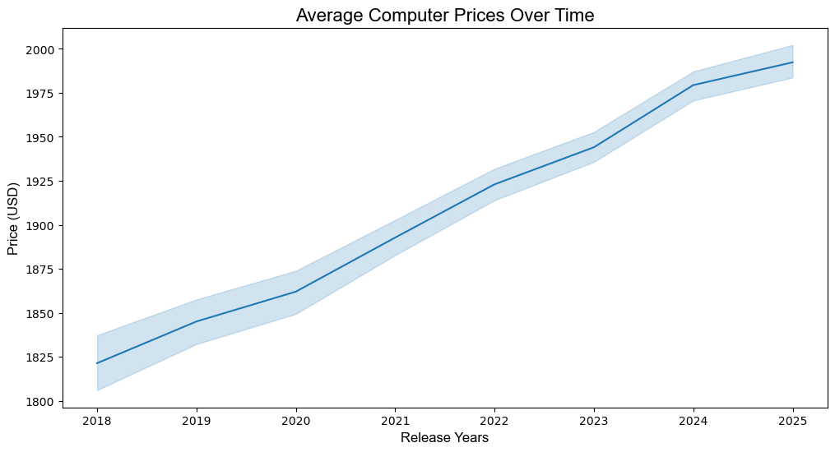
Notes:
“The shaded area represents the 95% confidence interval, showing the range where we expect the true average price to lie,
giving insight into the reliability of the trend.”

Slide 4
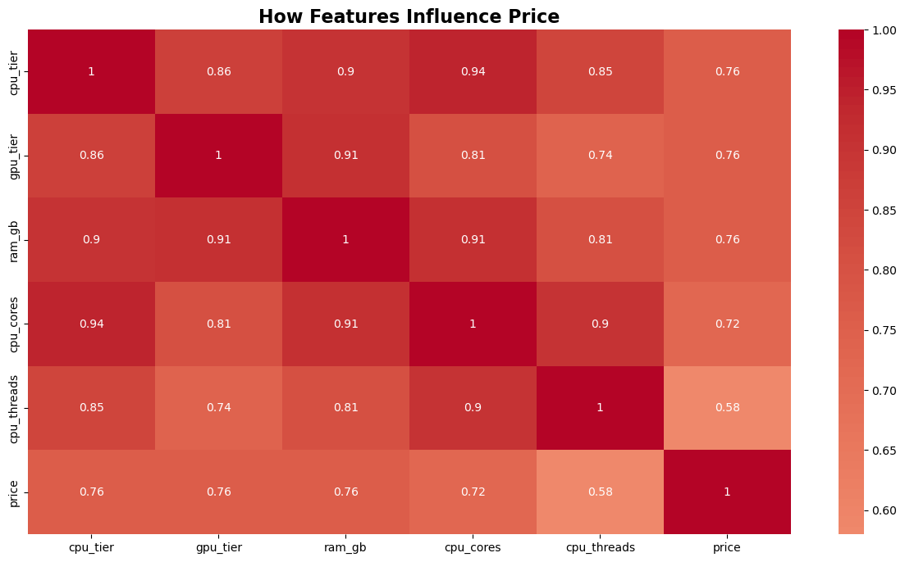

Slide 5
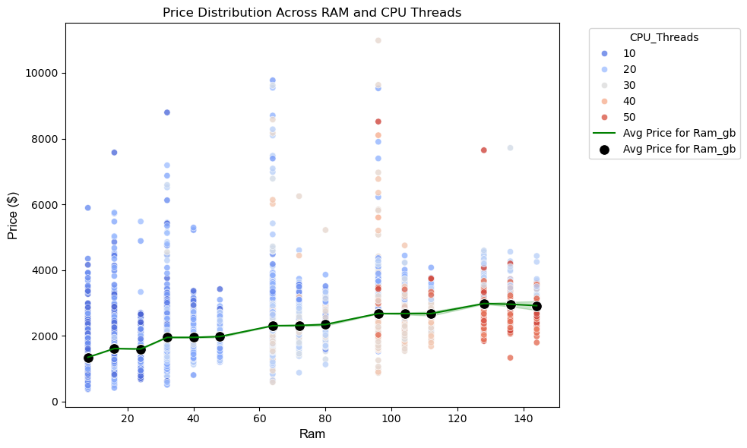
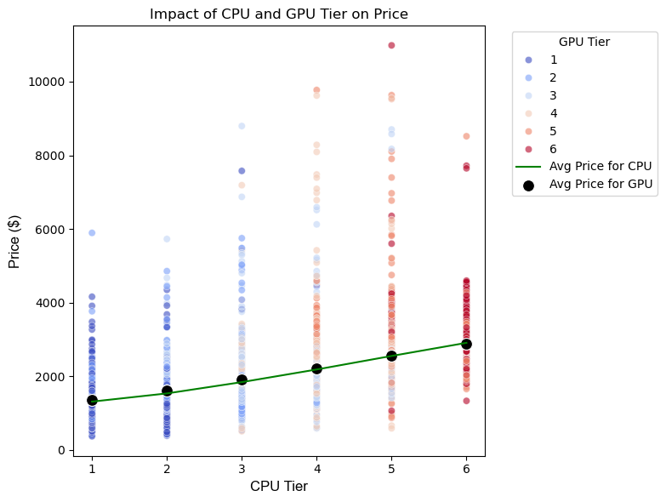

Slide 6
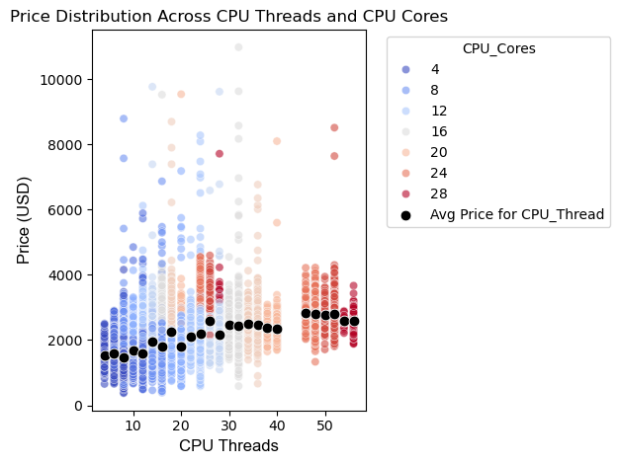

Slide 7
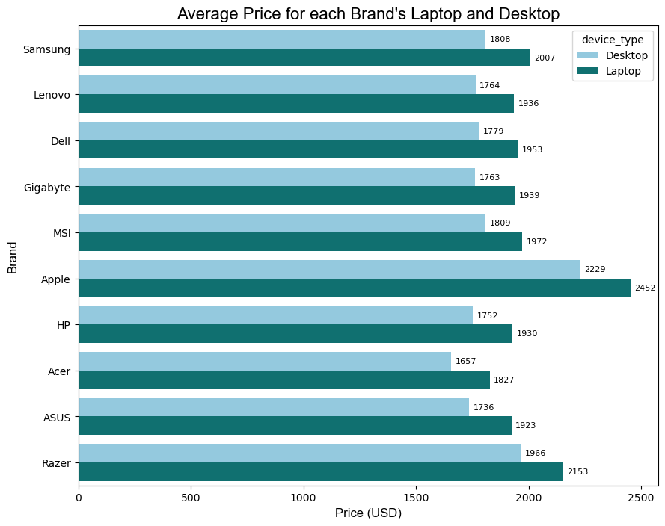
Notes:
“The shaded area represents the 95% confidence interval, showing the range where we expect the true average price to lie,
giving insight into the reliability of the trend.”

Slide 8
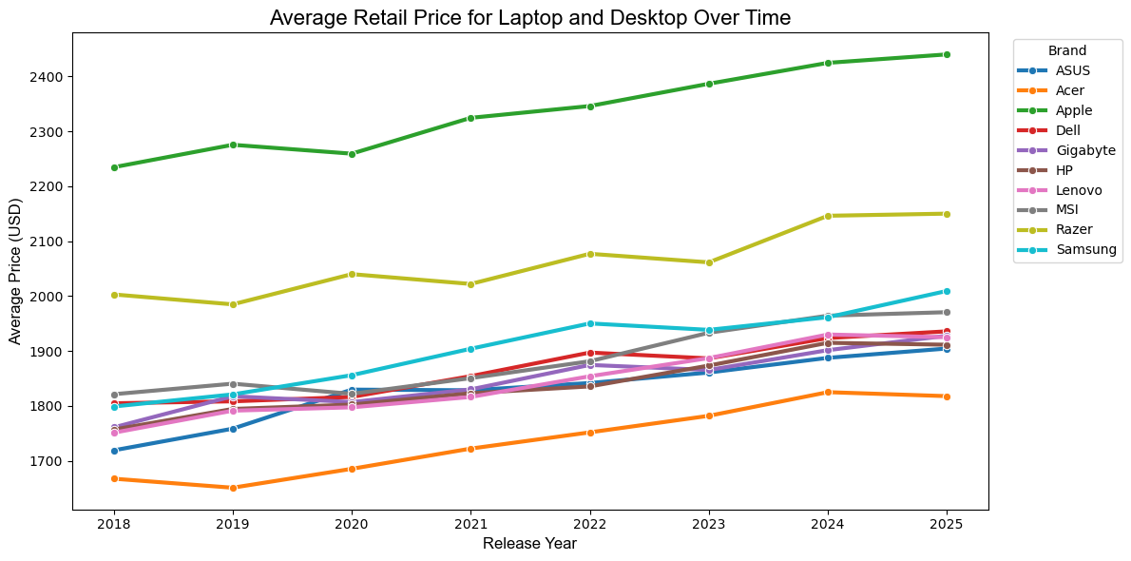
Notes:
“The shaded area represents the 95% confidence interval, showing the range where we expect the true average price to lie,
giving insight into the reliability of the trend.”

Slide 9
Future Areas of Research
Apply a Machine Learning Model
Include more Datasets (e.g: Count of Devices sold, Brand's Stock)
Analyze the other features' correlation (OS, CPU_Brand)
Create my own PcParts Builder

Slide 10

Summary
Average retail prices for desktop and laptop has been steadily increase overtime (8 years)
Consider finding a laptop/desktop with good quality of CPU and GPU model
Shopping Brand recommendation when there's a tech sale
1st: Baseline -> Lenovo, HP, Dell
2nd: Anything than Gaming -> Apple
3rd: Gaming -> Razer (Premium), ASUS (Cost-effective)

Slide 11
Thank You
Python Libraries: Pandas, NumPy, Matplotlib, Seaborn
Data Source: All Computer 2025
https://www.kaggle.com/datasets/paperxd/all-computer-prices/data
Github: https://github.com/hhnguyen72/Exploring_Computer_Prices

